Slide 1
How to register on EduNav with an add code

Slide 2
How do you access EduNav?
When you attempt to register for classes on WebAdvisor or My Portal you will automatically be redirected to EduNav if your Program of Study is supported
User recommendations: Use Chrome browser & PC or Laptop and avoid iPad & mobile device.
Notes:
Chrome seems to be the best browser when working with EduNav. If you are having problems accessing EduNav, try using Chrome.

Slide 3
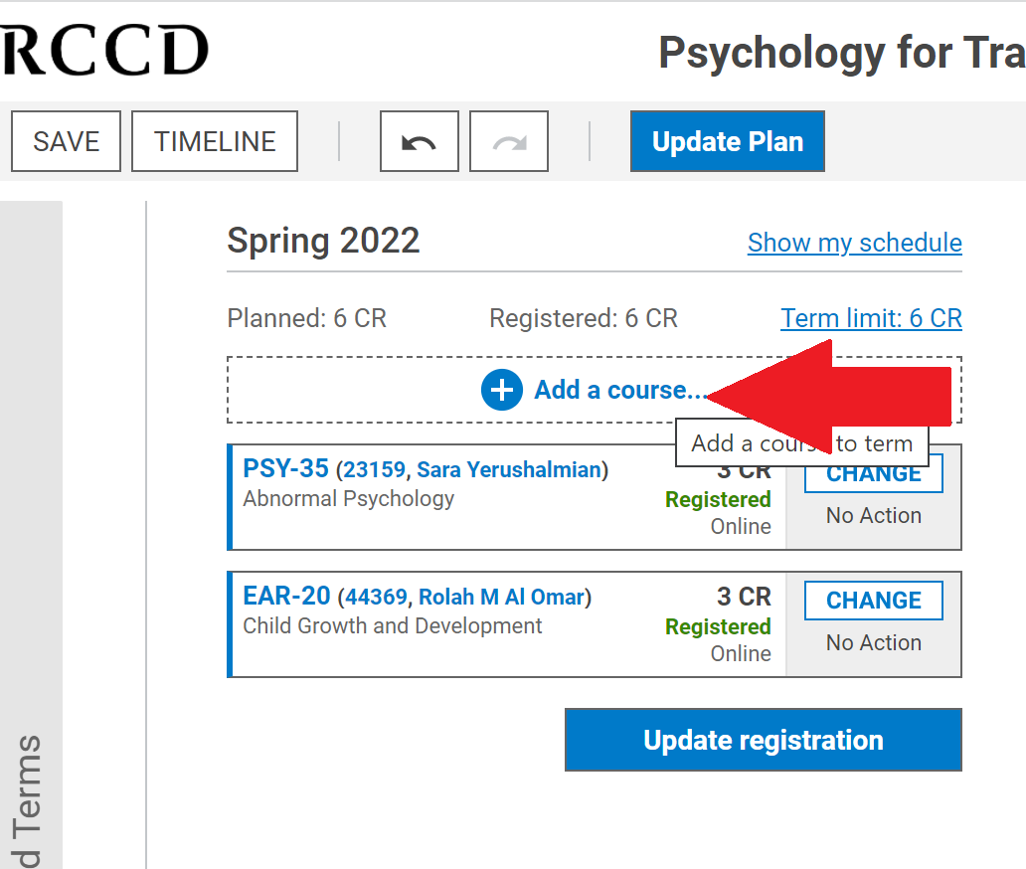
From EduNav click on the Add a course button

Slide 4
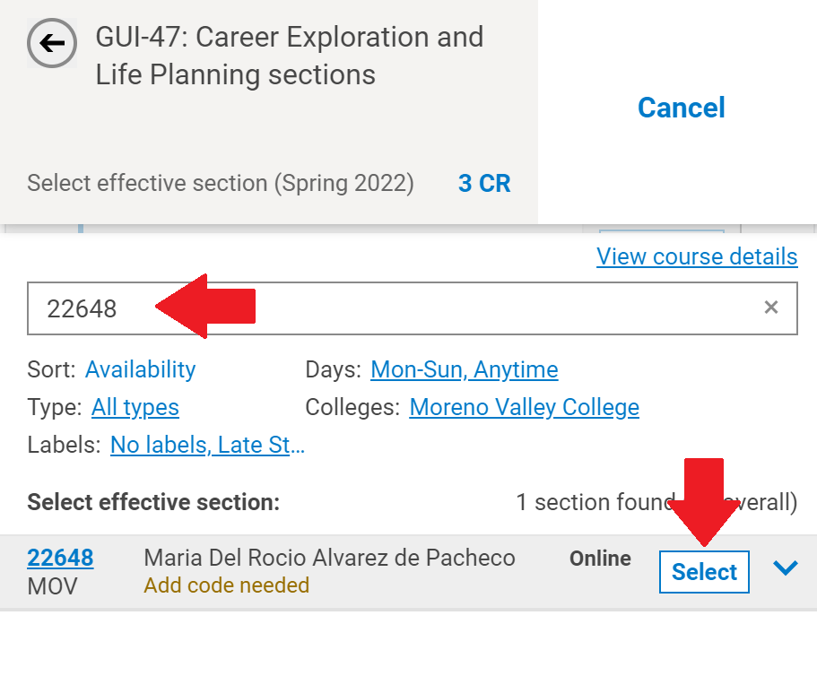
Type in the section # of the course and click the select box
Colleges:
Option to filter colleges to search for classes within the district.
Example: Riverside City College, Moreno Valley College, and Norco College

Slide 5
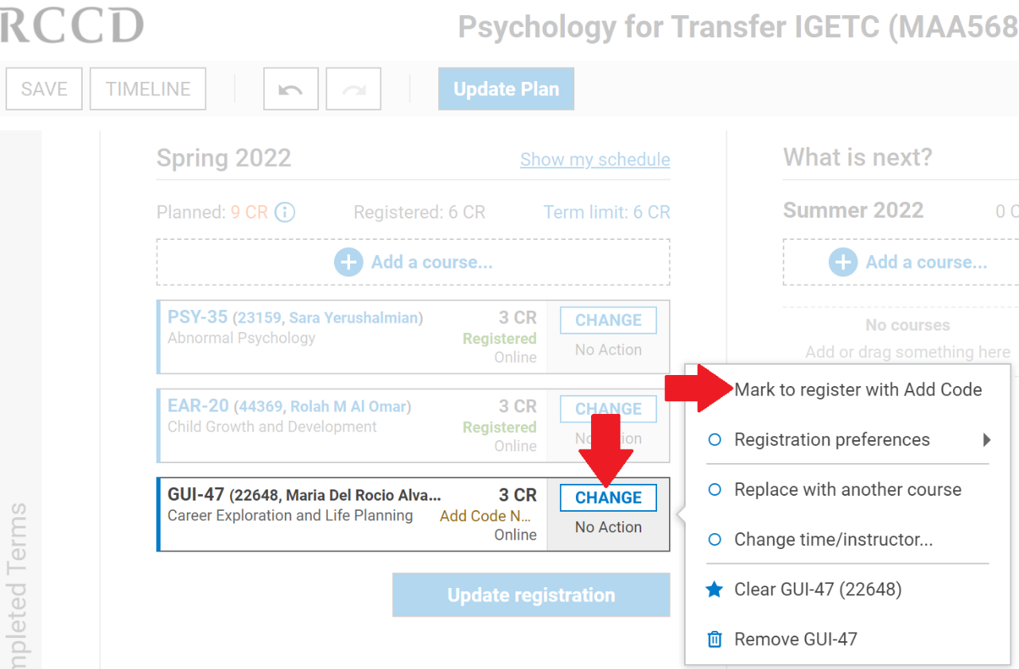
Next click on the CHANGE button and then the mark to register with an Add Code option

Slide 6
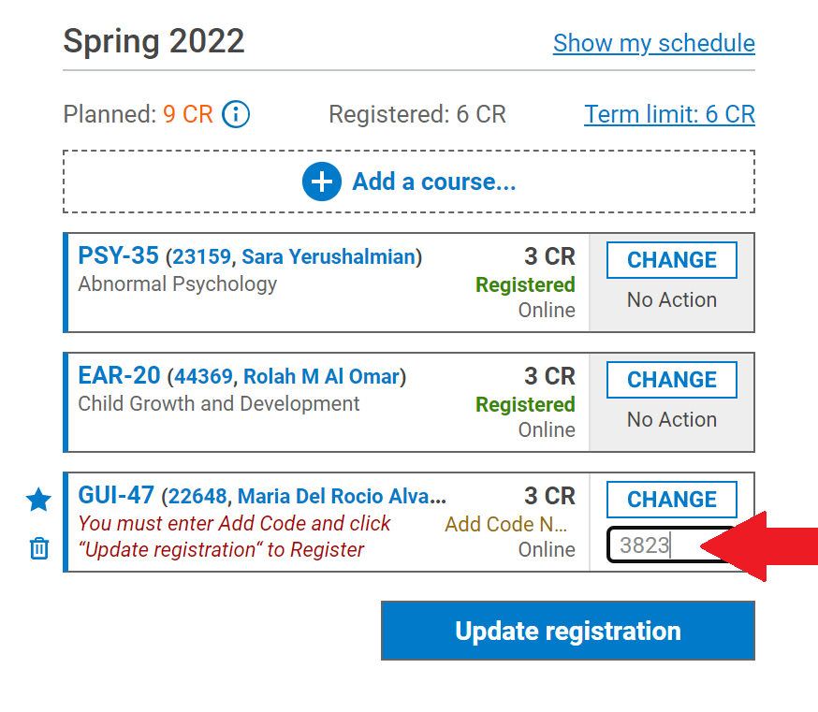
Under the CHANGE button, type in the add code given to you by your instructor and click on the Update Registration button.

Slide 7
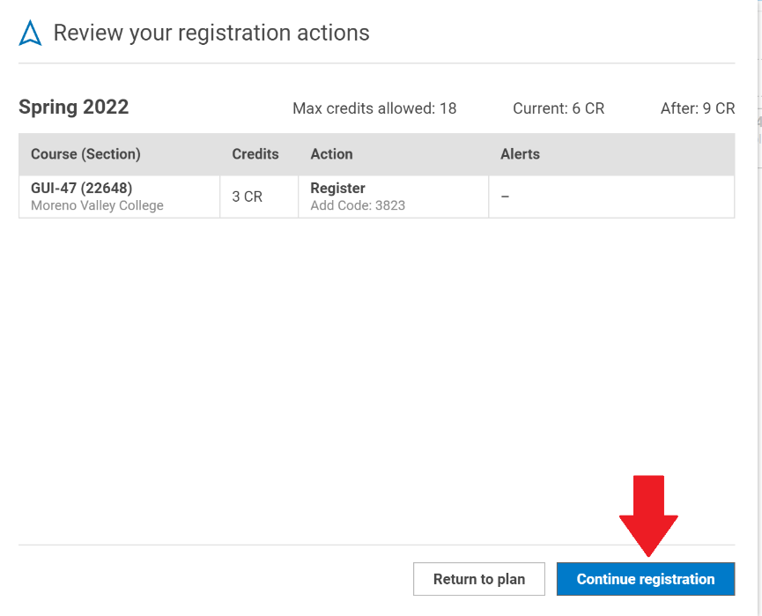
Review your registration actions and then click on the “Continue Registration” button.

Slide 8
Once you have registered you will see the Registration completed box. Click OK to go back to your plan.

Slide 9
The course you added will appear on your plan and the word Registered will appear in green next to the course.

Slide 10
Reminders
You must be fully vaccinated to be able to register for face to face or hybrid courses.
Student C​OVID-19 Reporting Procedure
​Students must report any positive test/diagnosis of COVID-19, COVID-19 exposure, or potential COVID-19 symptoms to their college Student Health Services department. The contact person at each location is:
Mo​reno Valley College-951-571-6103 or email healthservices@mvc.edu
Health Services Norco - call 951-372-7046 or email studenthealth@norcocollege.edu
Health Services RCC- call 951-222-8151 or email healthservices@rcc.edu
Notes:
If you need additional help navigating through EduNav you can visit the RCC home page. Staff is available to help you virtually right now. For days and times, please visit the Welcome Center.

Slide 11
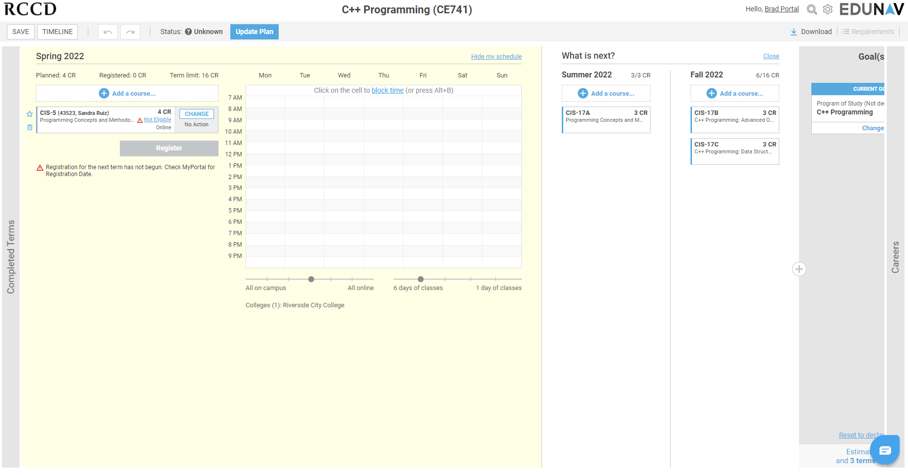
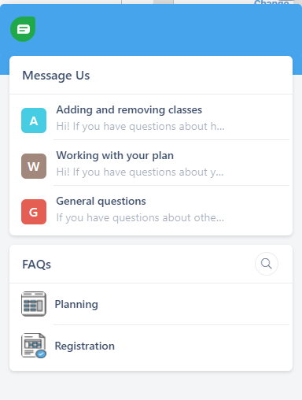
Help using EduNav
If you need help navigating through EduNav, you can use the chat feature within the Edunav student dashboard. See icon below.
*Chat typically replies within 5 minutes.

Slide 12
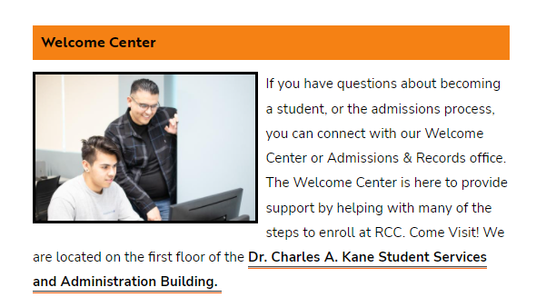
Help using EduNav
If you need additional help navigating through EduNav, you can visit your school's Engagement Center, a Student Success Team member, or the Welcome Center will be happy to assist you.
Academic Engagement Centers: https://www.rcc.edu/student-support/academic-engagement-centers/index.html
Welcome Center: https://www.rcc.edu/become-a-student/index.html
Notes:
If you need additional help navigating through EduNav you can visit the Welcome Center or Student Engagement Centers for support.

